Slide 1




Smart Gutter Monitoring and Management System Using IoT and AI
Team ID - 10603
Priya Gupta
Nikki Ram

Slide 2
Project Objectives
The primary objective of this project is to develop a Smart Gutter Monitoring and Management System that ensures efficient drainage and prevents water-related damage. The system will continuously monitor gutter conditions in real time, detecting changes in water levels, flow rates, and environmental factors that may indicate potential issues. By integrating sensors and IoT technology, the system will accurately identify blockages, leaks, and water accumulation, allowing for early intervention. Furthermore, the collected data will be processed and displayed on a user-friendly dashboard or mobile application, providing real-time insights to property owners or maintenance teams. The system will also feature an automated alert mechanism, sending notifications when anomalies such as excessive water buildup, debris accumulation, or structural damage are detected. By enabling proactive maintenance, the solution minimizes the risk of flooding, structural damage, and costly repairs. Ultimately, this project aims to create an efficient and AI-driven predictive maintenance system that enhances urban water management and improves the overall resilience of drainage infrastructure.

Slide 3
Problem Statement
During the rainy season, blocked or damaged gutters can lead to severe issues such as water overflow, flooding, and property damage. Traditional methods of monitoring and cleaning gutters are reactive, inefficient, and labor-intensive. There is a need for a smart solution that can proactively monitor gutter conditions, detect potential blockages or leaks, and provide real-time alerts to prevent damage and ensure effective water drainage.
Overflow due to heavy rainfall, leading to waterlogging and potential property damage.
Blockages caused by leaves, debris, and silt accumulation, reducing drainage efficiency.
Stagnant Water resulting from poor flow, creating a breeding ground for pests and mosquitoes.
Structural Damage due to prolonged clogs and unattended water retention.
High Maintenance Costs owing to the need for frequent manual cleaning and inspection.
The Smart Gutter Management System aims to provide a proactive, automated solution to monitor and address these issues using IoT and sensor-based technology.

Slide 4
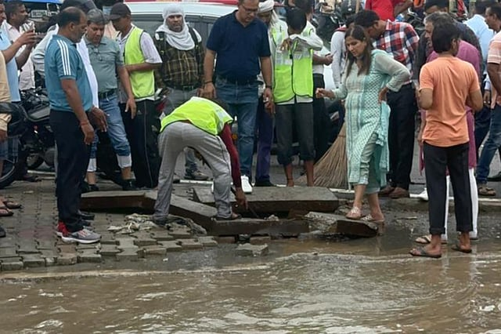
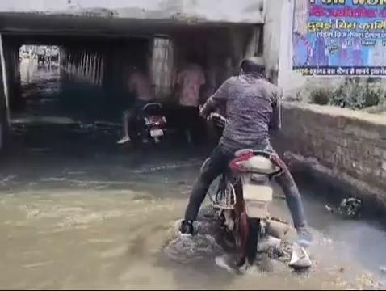

Slide 5
Project overview - Introduction
This project involves designing and implementing an IoT-based Smart Gutter Management System to prevent drainage inefficiencies. The system will consist of multiple interconnected components, including water level sensors, flow rate detectors, and automated blockage removal mechanisms. These components will work collaboratively under a cloud-based AI-driven monitoring system to ensure optimal water flow and minimal manual intervention.The proposed solution integrates sensors, automation, and cloud-based monitoring to:
Detect and monitor water flow levels in real-time.
Identify blockages and debris accumulation.
Send instant alerts and notifications to users.
Utilize AI/ML to predict potential drainage issues.
Provide user-friendly mobile and web interfaces for real-time monitoring and control.
This project not only aims to address immediate drainage concerns but also provides a scalable, smart city-compatible solution to enhance urban water management and sustainability.

Slide 6
End User
The smart gutter system is beneficial for various stakeholders, including:
Homeowners: Protects residential properties by preventing water damage, reducing maintenance efforts, and ensuring efficient water drainage.
Municipal Authorities: Enables efficient management of large-scale public drainage networks, reducing the risk of urban flooding and minimizing infrastructure maintenance costs.
Commercial Buildings: Ensures seamless rainwater drainage, preventing operational disruptions, property damage, and potential safety hazards for businesses.
Industrial Facilities: Reduces downtime caused by poor drainage and stagnant water, which can lead to safety risks, equipment damage, and production losses.
Smart Cities Initiatives: Enhances urban drainage management by integrating with existing smart infrastructure, enabling data-driven decision-making, real-time monitoring, and predictive maintenance for optimized water management.

Slide 7
Wow Factor in Solution
This project stands out due to its advanced features:
Real-time Data Monitoring: The system continuously tracks water levels, flow rate, and debris status, ensuring up-to-date information on drainage conditions.
IoT and Cloud Integration: Provides remote access and control via mobile and web applications, allowing users to monitor and manage drainage systems from anywhere.
AI-Powered Predictive Maintenance: Uses historical data and weather forecasts to predict potential drainage failures, enabling proactive solutions before blockages or overflows occur.
User Alerts and Notifications: Sends SMS, email, or app alerts when issues are detected, ensuring immediate response and quick decision-making.
Self-Learning Mechanism: The system improves over time by learning from past drainage patterns, optimizing responses to different weather conditions and potential risks.
Customizable Settings: Users can define their own thresholds for alerts and drainage responses, tailoring the system to their specific needs and environmental conditions.

Slide 8
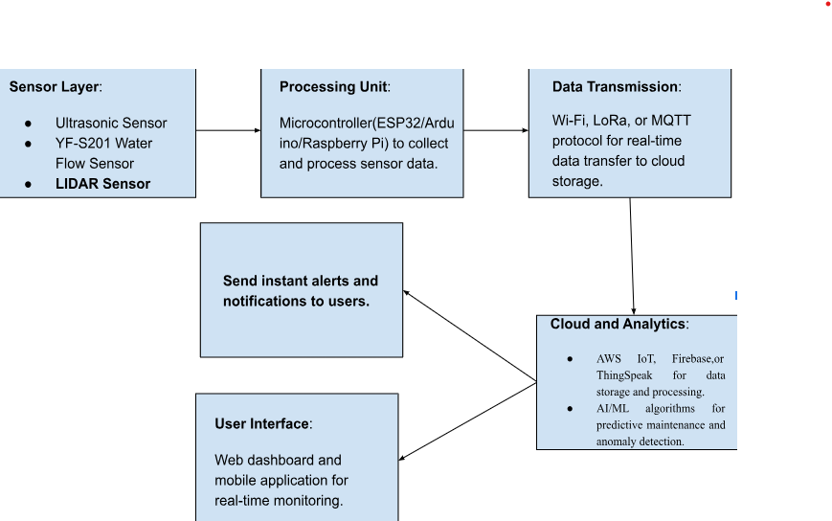
Modelling

Slide 9
Result
The Smart Gutter Management System is expected to achieve:
Enhanced Water Drainage Efficiency: Continuous monitoring prevents overflow and stagnation, ensuring optimal water movement even in extreme weather conditions.
Minimized Flooding and Water Damage: Real-time alerts enable quick action, preventing severe water damage to residential, commercial, and public infrastructure.
Optimized Resource Usage: AI-driven analytics help in predictive maintenance, reducing unnecessary repairs and maximizing the efficiency of drainage systems.
Improved Safety and Hygiene: By preventing water stagnation and clogging, the system reduces breeding grounds for mosquitoes and other pests, improving public health and safety.
Scalability and Adaptability: The system can be deployed across various environments, from small residential areas to large-scale urban infrastructure, ensuring adaptability to different drainage challenges.
Data-Driven Decision Making: The integration of cloud and AI-based analytics provides insightful reports for municipalities and urban planners, enabling better resource allocation and infrastructure improvements.

Slide 10
Conclusion
The Smart Gutter Management System offers a revolutionary approach to addressing drainage issues using modern technology. By integrating IoT, AI, and automation, it enhances efficiency, reduces manual labor, and ensures proactive maintenance. Its key benefits include:
Prevention of water stagnation and blockage-related damages.
Increased cost-effectiveness through predictive maintenance.
Improved urban drainage infrastructure for smart city initiatives.
Scalable and adaptable solutions for different environments.
This system represents a significant step towards intelligent water management, ensuring safer and more efficient drainage solutions.

Slide 11
Future Perspective:
The project can be enhanced further with advanced features such as:
AI-based Predictive Analytics: Implement deep learning models to forecast potential drainage failures.
Integration with Smart City Infrastructure: Connecting with municipal drainage networks for large-scale optimization.
Solar-Powered Units: Increasing sustainability by utilizing renewable energy sources.
Enhanced User Interface: AI-driven chatbot support and voice-command capabilities for better user interaction.
Camera-Based Monitoring: Implementing AI-enabled cameras to detect debris accumulation and structural issues, enhancing real-time surveillance and automated decision-making.
By expanding its capabilities, the Smart Gutter Management System can play a significant role in modern drainage solutions and smart urban planning.

Slide 12
Thank you...!
Notes:
12

